Slide 1
Strategic Management
Dr. Marwa Tarek
9th class
Selecting the strategy

Slide 2
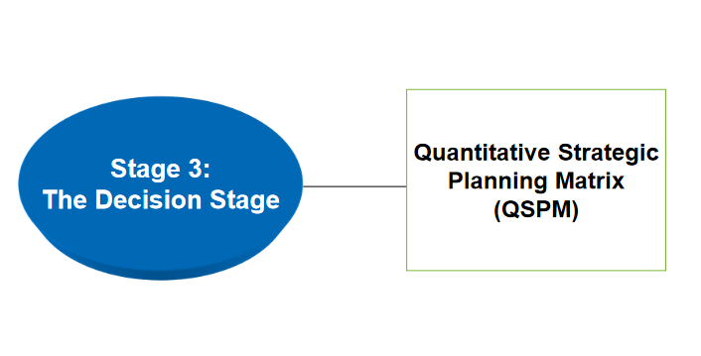
Strategy-Formulation Analytical Framework
After locating the company in one of the quadrants, it is the time to move to the third stage of the Strategy-Formulation Framework to select one of the available strategies in this quadrant.

Slide 3
QSPM Quantitative Strategic Planning Matrix
Technique designed to determine the relative attractiveness of feasible alternative actions and thus provides objective basis for selecting specific strategies.
QSPM depends mainly on EFs and IFs in the input stage of the compréhensive strategy-Formulation Framework (stage no. 1).
Example : if the company is located in the defensive quadrant, so we have three strategies;
Retrenchment
Divestiture
liquidation

Slide 4
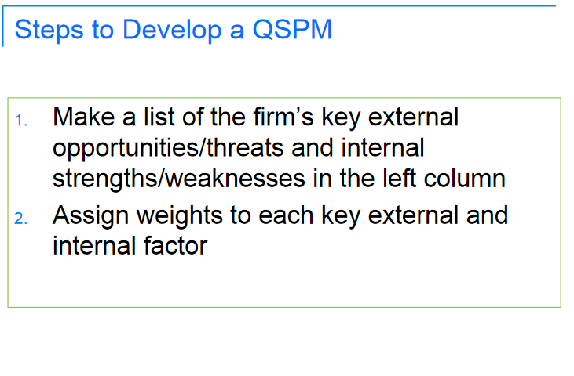

Slide 5
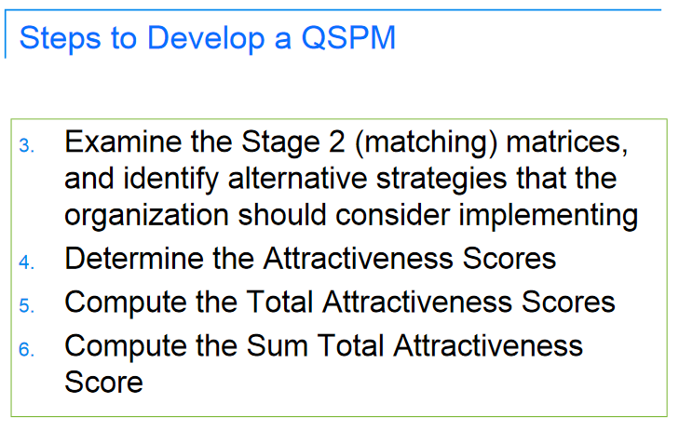

Slide 6
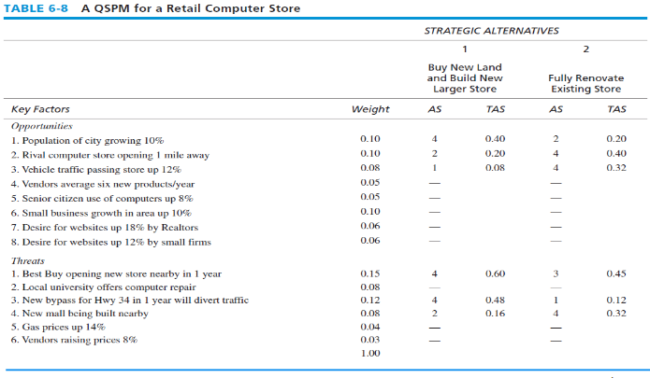
A QSPM for a Retail Computer Store
AS stands for “attractiveness scores” and TAS stands for “total attractiveness scores”.

Slide 7
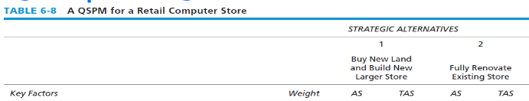
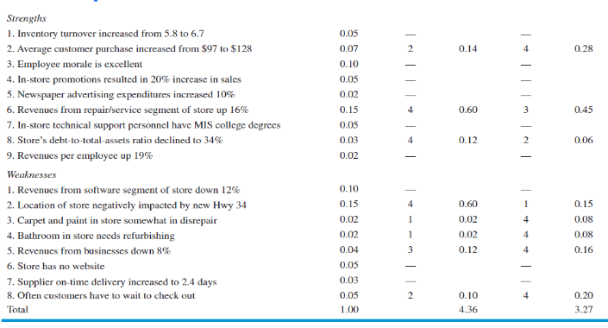
A QSPM for a Retail Computer Store

Slide 8
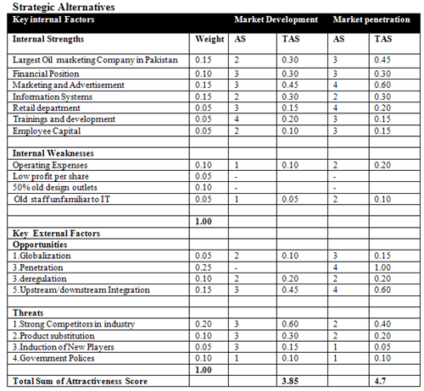
A QSPM for an oil marketing company

Slide 9
Steps to develop QSPM
Determine the (AS) Attractiveness scores (Does this factor affect the choice of the strategy being made?) This is a “yes” and “no” answer for each single (T, O, S, A & W).
If “yes”, the range for Attractiveness scores is 1= Not Attractive, 2= Somewhat attractive, 3=Reasonably Attractive, and 4=Highly Attractive.
If “no” indicating that the respective key factor has no effect upon the specific choice being made, then don’t assign Attractiveness scores to the strategies in that Set. So, use a ”Dash” to indicate that the key factor doesn’t affect the choice being made.

Slide 10
So what is the difference between (the dash) and (Not Attractive) ?
Dash means that this factor is totally rejected as far as it has no effect on the choice of the strategies being made, whereas the “ Not Attractive” is the least attractive factor.
Note: if one strategy receives ”Dash” then ALL other strategies must receive a ”Dash” in a given row.
Example if I am in the defensive quadrant and having an opportunity to open a new branch in one of the gulf countries, and the strategy that I am testing is the retrenchment. If the strategists found that it has no effect I have to put a dash in the column of the retrenchment strategy and the other strategies in the same quadrant (i.e. Divestiture and liquidation). So work row by row not column by column.
The logic here is we have to use the same criteria in selecting the strategy being implemented.

Slide 11
Steps to develop QSPM
TAS is the multiplication of the weight and the AS for every single factor for every single strategy.
Then sum all the TAS for each strategy and the highest score of TAS means this strategy is more attractive to be implemented.

Slide 12
Limitation of QSPM
It requires intuitive informed judgement.
This means that the matrix requires to have educated assumptions and judgements.
It seems to be a subjective process, however to make it more objective, each strategist should prepare his/her own QSPM and then all of them have to agree upon a one consolidated QSPM OR to discuss the AS together and getting the final QSPM.

